Slide 1
Cognitive demand forecasting in retail business Using Machine Learning
Presentation by:
* Rishit Dholakia(U15CO013)
* Riya Dholakia(U15CO014)
* Hunsii Ashar(U15CO016)
* Richa Randeria(U15CO018)
• Guided by: Dr. Dipti Rana, Associate Professor, COED

Slide 2
Our Previous Presentation
Introduction
Literature Survey
Proposed Framework

Slide 3
What are we going to discuss today?
Data Preprocessing
Visualization

Slide 4
Data Preprocessing
Data Cleaning
Data Transformation
Feature Engineering

Slide 5
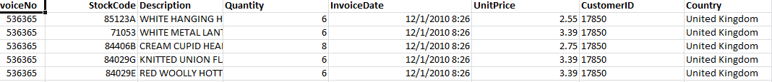
Data Cleaning
Benefits of Data Cleaning
Common Steps in Data Cleaning
Original Dataset
Fig. 4.1 Original Dataset

Slide 6
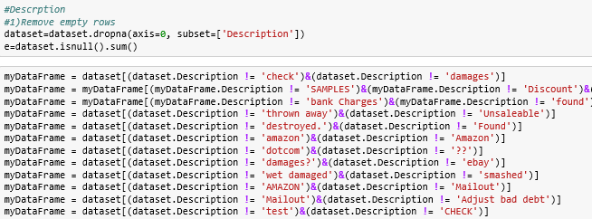
Steps undertaken in the project for Data Cleaning for Specific Attributes
Description
Fig. 4.2 Data cleaning step 1

Slide 7


Steps undertaken in the project for Data Cleaning for Specific Attributes
Quantity
Fig 4.3 Data Cleaning step 2
UnitPrice
Fig 4.4 Data Cleaning step 3
CustomerID
Fig 4.5 Data Cleaning step 4

Slide 8
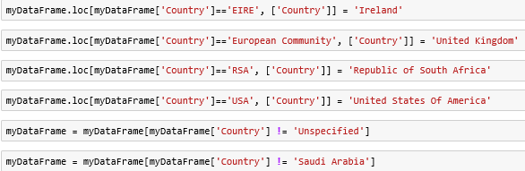
Steps undertaken in the project for Data Cleaning for Specific Attributes
Country
Fig 4.6 Data Cleaning step 4
In addition: Removal of Duplicate Records
Fig 4.7 Data Cleaning step 5

Slide 9
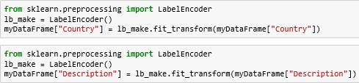

Data Transformation
Converting Categorical Values To Numerical Form
Fig. 4.8 Data Transformation step 1
Normalization
Fig. 4.9 Data Transformation step 2

Slide 10
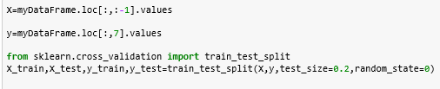
Also, Train-Test Split
Fig. 4.10 Train Test Split

Slide 11
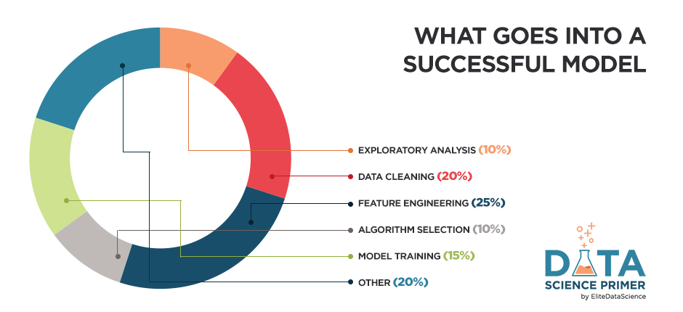
Feature Engineering
Importance of Feature Engineering
Techniques for Feature Engineering?

Slide 12
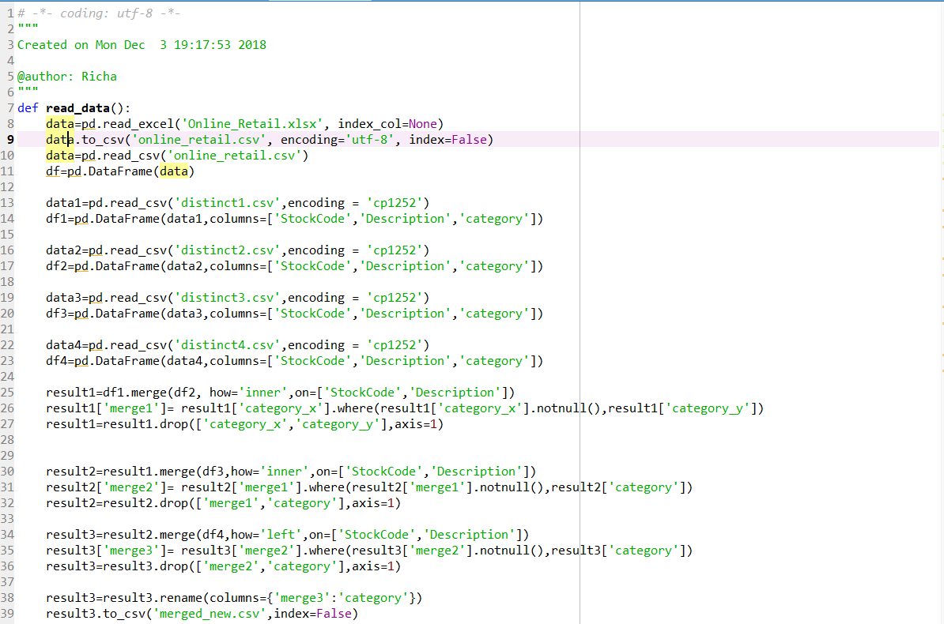
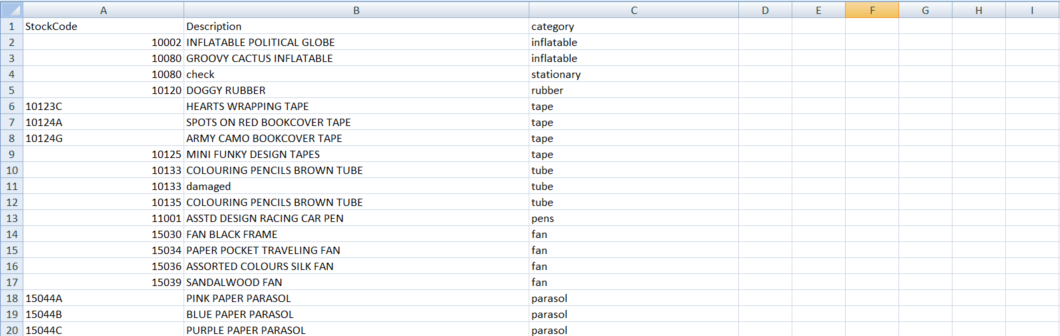
Labeling Item-set
Fig. 4.12 Output of labeling item-set
Fig. 4.11 Code for labeling item-set

Slide 13
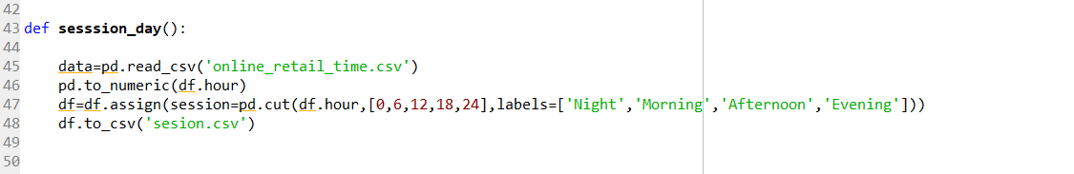
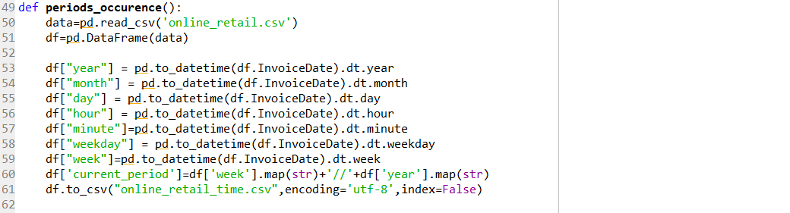
Feature Extraction
Sessions of the Day and weekdays
Fig. 4.13 Code for sessions of the day
Fig. 4.14 Code for splitting date attribute

Slide 14
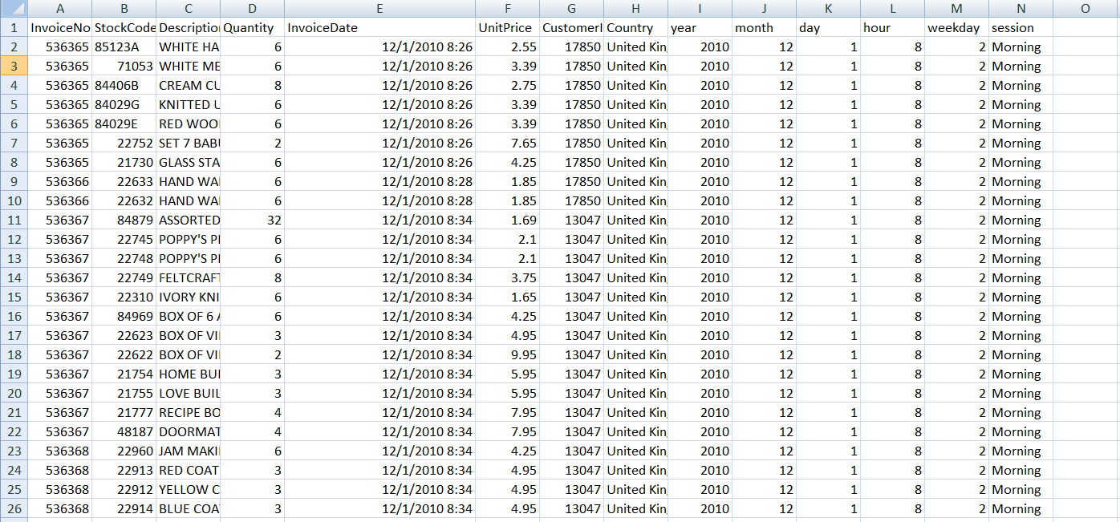
Fig. 4.15 Output of splitting date

Slide 15

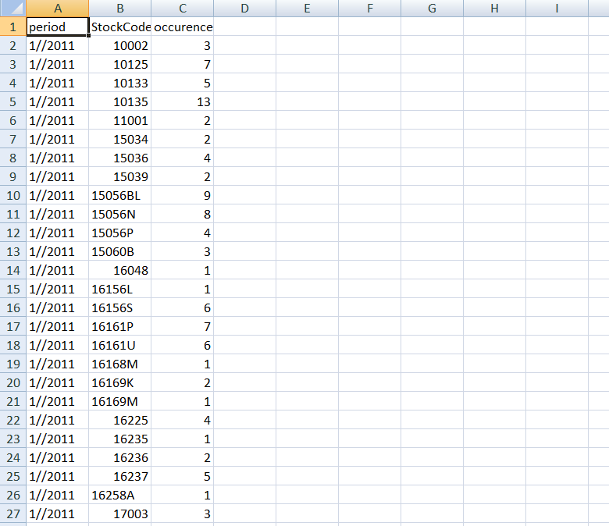
Past week sales
Occurrence in each week
Fig. 4.16 Code for occurrence of each week
Fig. 4.17 Output of frequency of each item

Slide 16
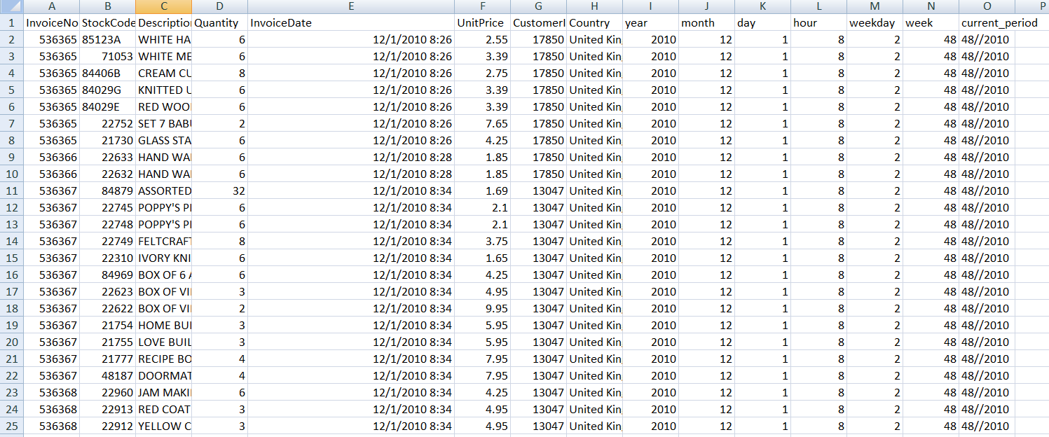
Fig. 4.18 Output of generating current periods

Slide 17
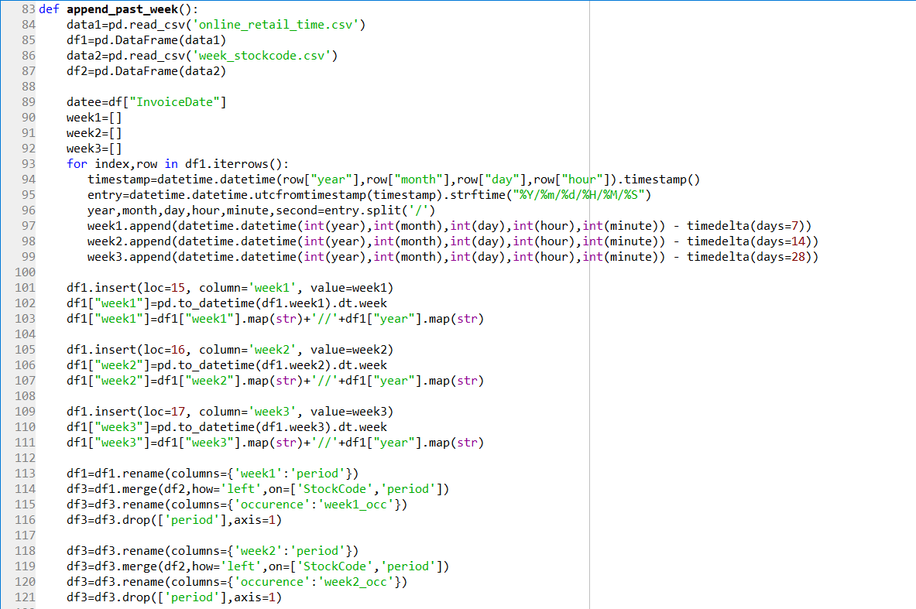
Fig. 4.19 Code to generate past week

Slide 18
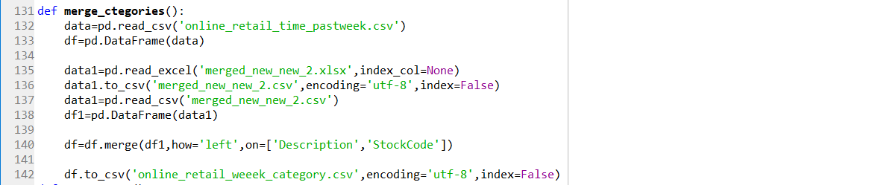
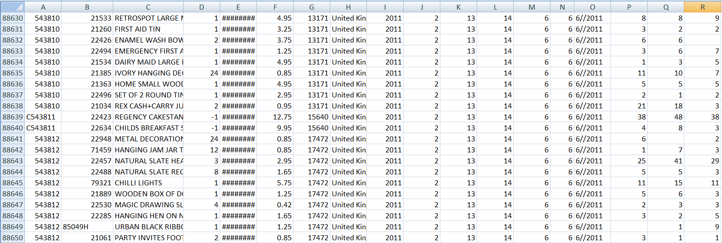
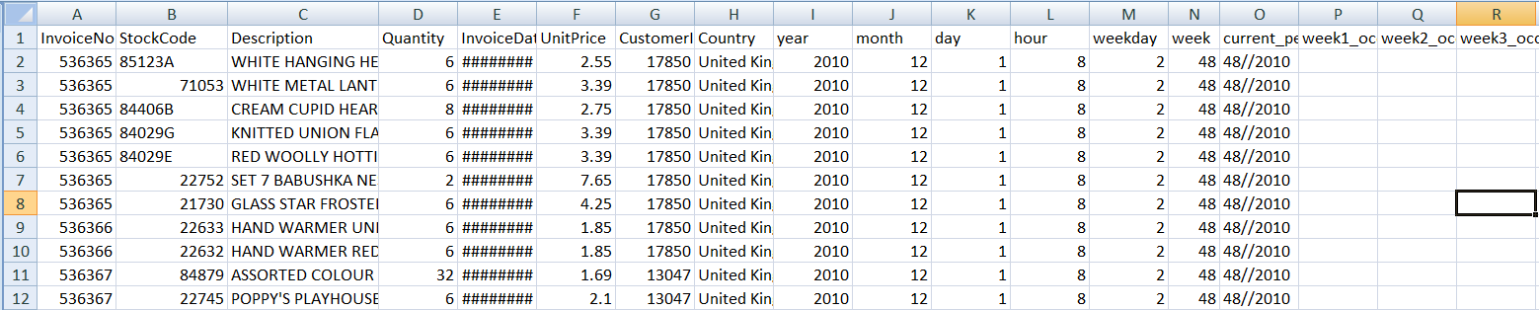
Merging two datasets
Fig. 4.20 Code for merging categories
Fig. 4.21 Output of past sales in first week
Fig. 4.22 Output for past sales for subsequent weeks

Slide 19
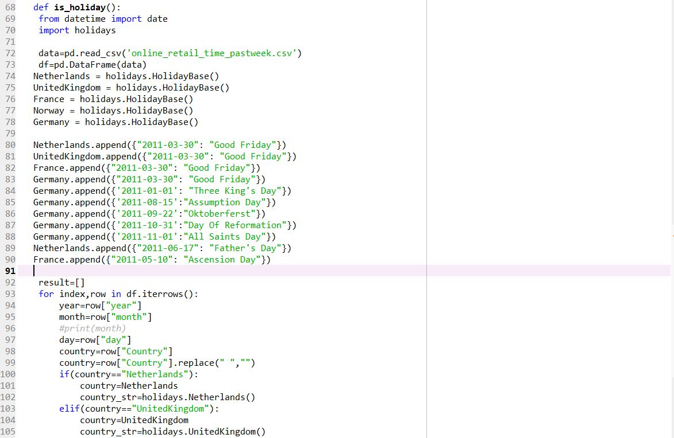
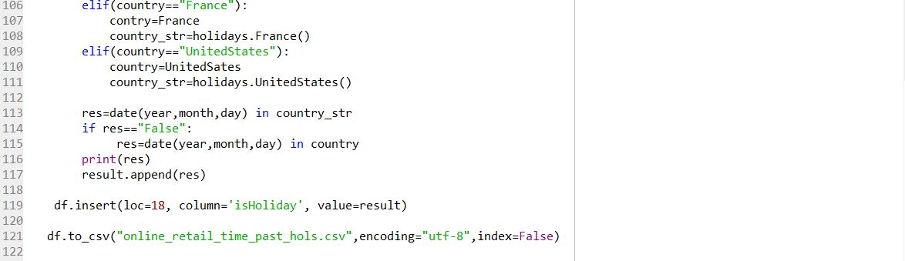
Feature Augmentation
Holidays
Fig. 4.23 Code for holiday

Slide 20
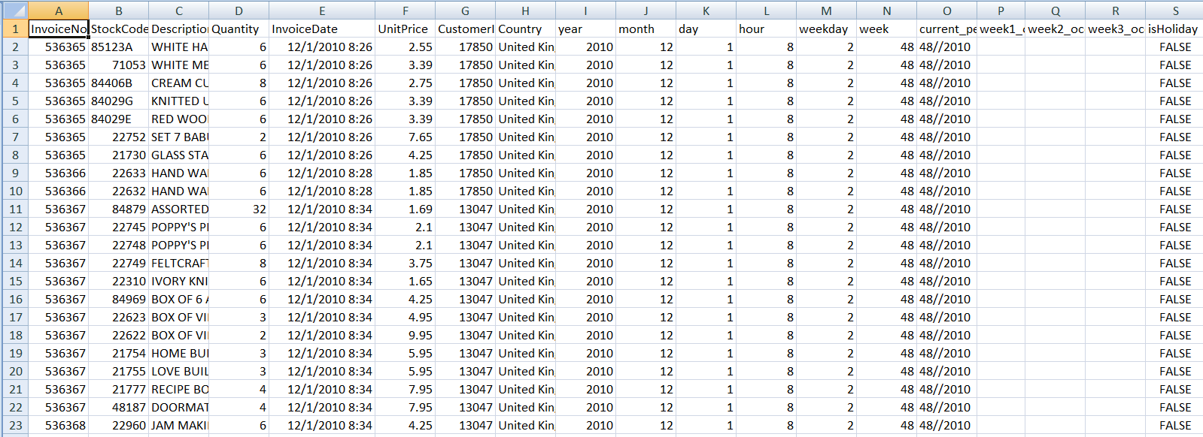
Fig. 4.24 Output for generating the holidays feature

Slide 21
Natural Language Processing in Retail

Slide 22
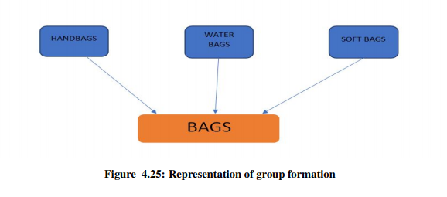
Categorization of the sub-groups
Grouping the different item sets
Many unique values

Slide 23
Why NLP ?
Human labor
Time consuming
Increases efficiency
Intelligent grouping

Slide 24
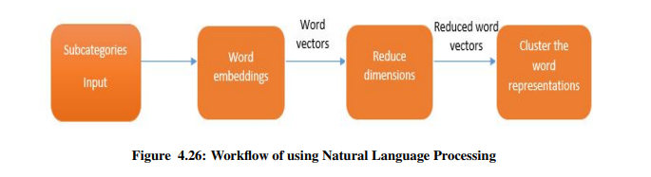
Workflow

Slide 25
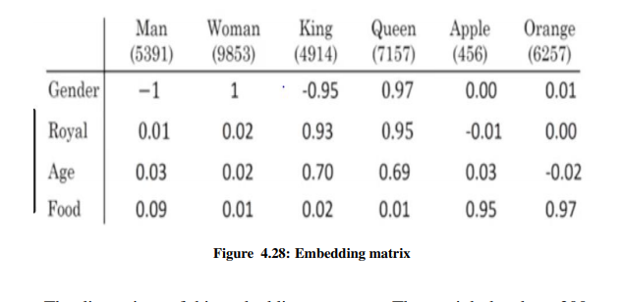
Word Embeddings

Slide 26
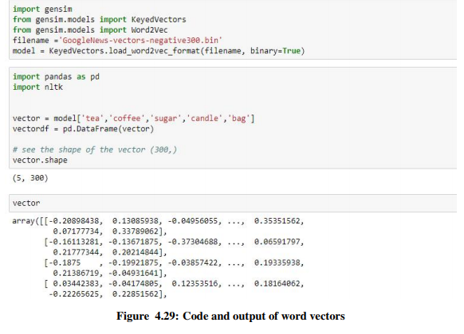
Word vectors

Slide 27
Reduction of the dimension
Cannot visualize
Too large to do computation on
Using the PCA algorithm
Reducing to two dimensions to visualize

Slide 28
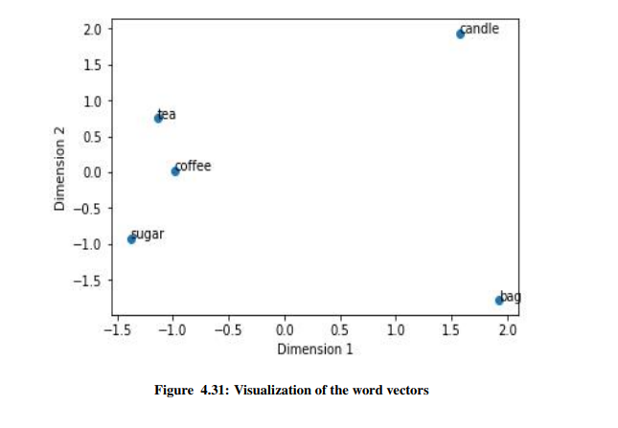
Visual Representation

Slide 29
Working clusters
Clustering the word representation
Using defined number of clusters
K-means clustering

Slide 30
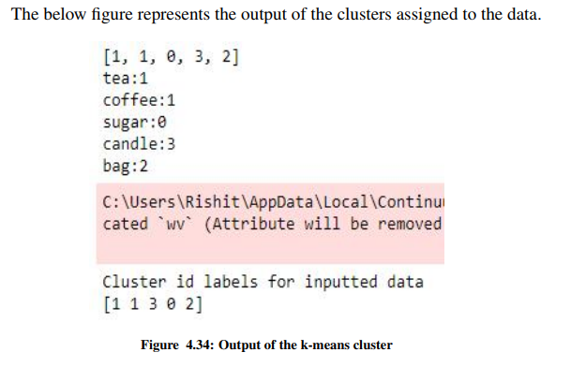
Output of using k-means clustering

Slide 31
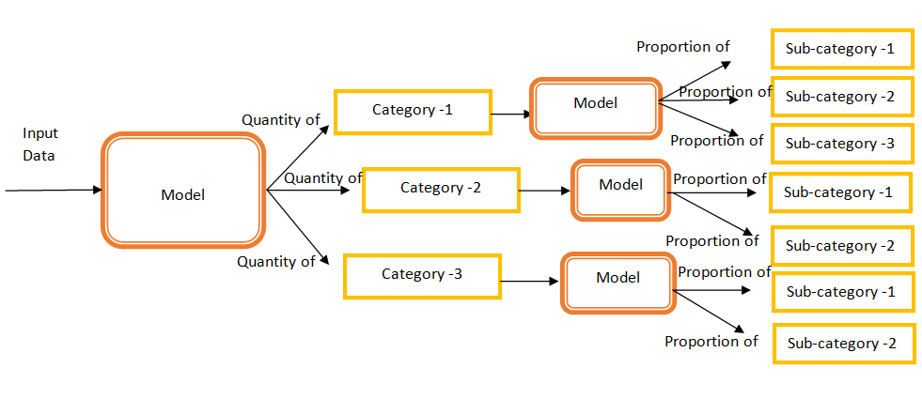
Future Works And Summary
Creating Sub-categories
Fig. 6.1 Holistic overview for prediction

Slide 32
2. Experimenting with Models
3. Statistical reports of sales
4. Cluster most frequently bought items
5. Automated dashboard in Tableau
6. Implement models using inherent regularities observed during visualization

